Slide 1
VISUALIZING FORESTS
Tran Nguyen Trong Phu
Notes:
So far we have been discussing visualization of individual tree models.We have shown, however, that there is an inherent volatility in the choice of splits that may affect the stability of a given model.
Therefore it is useful to grow multiple trees

Slide 2
CONTENT
1. Split variables
2. Data view
3. Trace plot

Slide 3
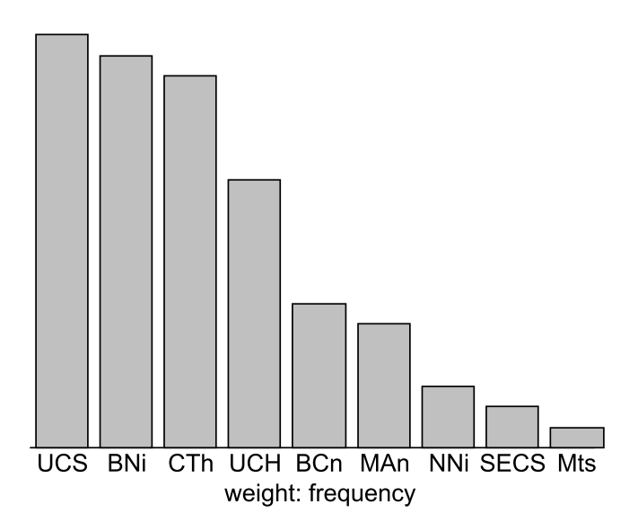
SPLIT VARIABLES
Visualization of forests on Wisconsin breast cancer data
Figure .. Frequency of use of individual variables in  bootstrapped tree models
Notes:
-20 trees using bootstrapping -first concentrate on the variables used in the models : how often the corresponding variable was used in the models. The most often used variable is UCS (20 times) and the least often used variable is Mts,
which was used just once.
-Clearly this view is very coarse, because it does not take into account what role the
variable plays in the models. The number of splits can double with increasing depth,
whereas the number of involved cases decreases. Therefore the fact that a variable is
used often does not necessarily mean that it is really important especially if it used mainly in the fringe for small groups -Therefore it is advisable to weight the contribution of each split by a cumulative statistic such as the decrease of impurity
The cumulative value of impurity decrease for each variable of the  bootstrapped
trees is displayed in the right plot of Fig. .. The variables in each plot are ordered
by the bar height, representing their importance. We see that UCS is by far the most
influential variable, followed by UCH and BNi.

Slide 4
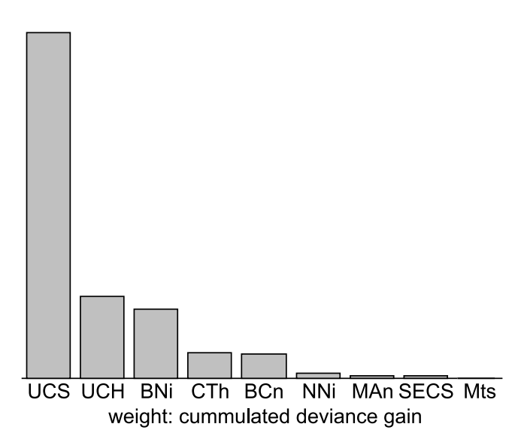
SPLIT VARIABLES
Visualization of forests on Wisconsin breast cancer data
Figure .. Right: cumulated deviance gain in splits featuring the corresponding variable
Notes:
-Therefore it is advisable to weight the contribution of each split by a cumulative statistic such as the decrease of impurity
The cumulative value of impurity decrease for each variable of the  bootstrapped
trees is displayed in the right plot of Fig.. The variables in each plot are ordered
by the bar height, representing their importance. We see that UCS is by far the most
influential variable, followed by UCH and BNi.

Slide 5
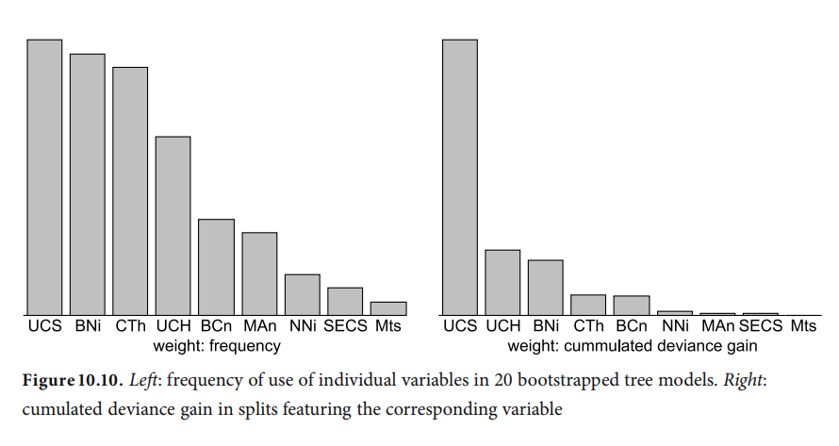
SPLIT VARIABLES
Visualization of forests on Wisconsin breast cancer data

Slide 6
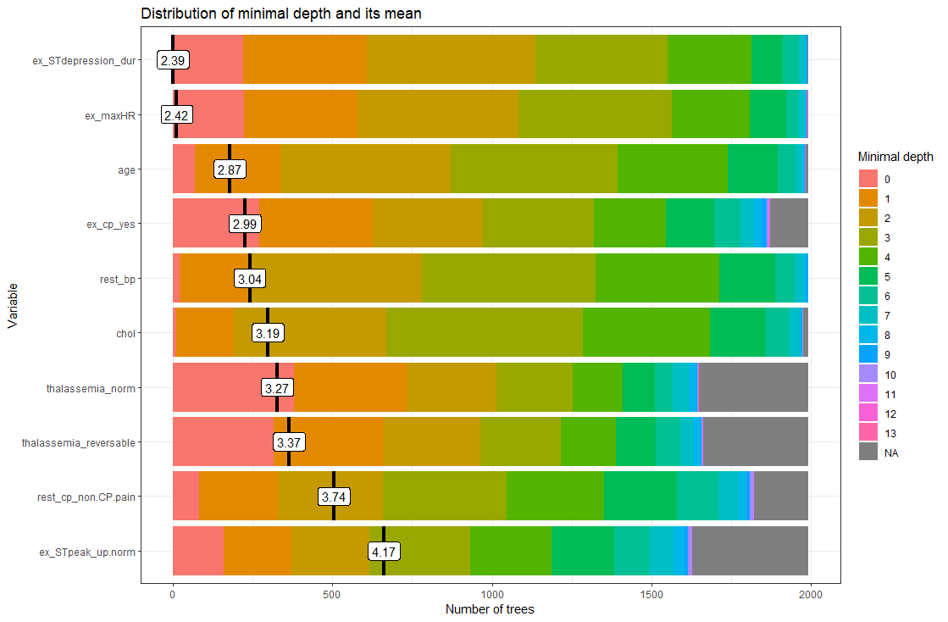
SPLIT VARIABLES
Notes:
Previously, we looked at various types of importance measures. Now we are specifically examining the mean minimal depth in detail. The distribution of the mean minimal depth allows us to appreciate the variable’s role in the random forest’s structure and prediction. plot_min_depth_distribution plots the top ten variables according to mean minimal depth calculated using top trees. The mean minimal depth can be calculated in 3 different ways in plot_min_depth_distribution using the mean_sample argument. The calculation differs in the way they treat missing values that appear when a feature is not used for tree splitting. As a result, the ranking of variables may change for each calculation.
The mean minimal depth is indicated by a vertical bar with the mean value beside it. The smaller the mean minimal depth, the more important the variable is and the higher up the y-axis the variable will be. The rainbow gradient reveals the min and max minimal depth for each variable. The bigger the proportion of minimal depth zero (red blocks), the more frequent the variable is the root of a tree. The smaller the proportion of NA minimal depth (gray blocks), the more frequent the variable is used for splitting trees. The range of the x-axis is from zero to the maximum number of trees for the feature.

Slide 7
SPLIT VARIABLES
Variable masking:
highly correlated variables, it is very likely that they will produce very similar split results
the CART algorithm guided pick one of them at random
Since the decision was made, the other variable is not likely to be used anymore. If one of the variables is “weaker,” it will hardly appear in any model, even though in the absence of the stronger variable it may still perform the best out of all the other variables.
Notes:
When making inference on the displayed information, we need to be cautious
and keep the tree properties in mind. Variable masking can heavily influence the
results of such analyses.
Given two highly correlated variables, it is very likely that they will produce very similar split results
Therefore the CART algorithm guided by the bootstrap will pick one of them at random
Since the decision was made, the other variable is not likely to be used anymore. If one of the variables is “weaker,” it will hardly appear in any model, even though in the absence of the stronger variable it may still perform the best out of all the other variables.

Slide 8
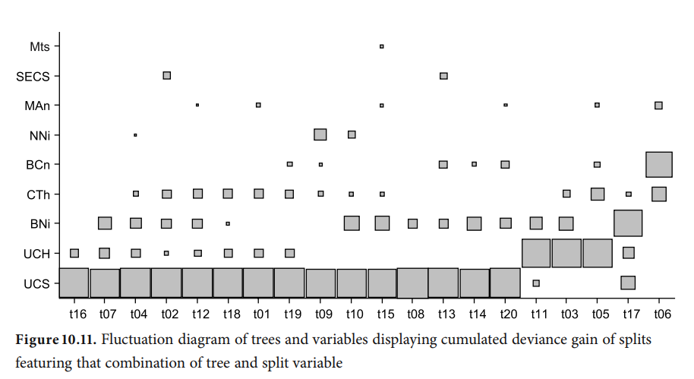
SPLIT VARIABLES
Notes:
Focusing on the largest gains, we can distinguish four different model groups. In 15 models, UCS is the most influential variable, followed by UCH with 3 models and BNi and BCn with one model each. Looking at the large group of 15 models we can also spot several patterns. In 8 cases, UCH is also used, although not contributing as heavily as in its dominant position, but then we see another 3 cases where UCH is not used at all. Visually we get the impression that BNi replaces UCH in those cases, which hints at variable masking. We see a similar behavior with UCS and UCH, too.

Slide 9
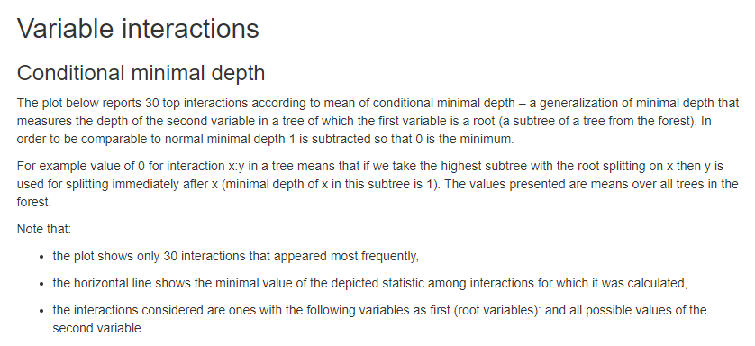
SPLIT VARIABLES
Notes:
The interaction is reflected as the mean_min_depth which is the mean conditional minimal depth, where a variable is taken as a root node/root_variable and the mean minimal depth is calculated for the other variable. The uncond_mean_min_depth represents the unconditional mean minimal depth of the variable which is the mean minimal depth of the variable without having a stipulated root variable. This value is the same as the mean value seen on the vertical bar in plot_min_depth_distribution.
Variable interaction The interactions are arranged from the most frequent occurring on the left side of the plot and in lighter blue to the least frequent occurring interaction on the right side of the plot and in darker blue. The horizontal red line represents the minimum mean_min_depth. The black lollipop represents the uncond_mean_min_depth. Similar to plot_min_depth_distribution, the ranking of interactions in plot_min_depth_interactions may change depending on the arguments for mean_sample and uncond_mean_sample.
Most frequent interaction: ST depression versus

Slide 10
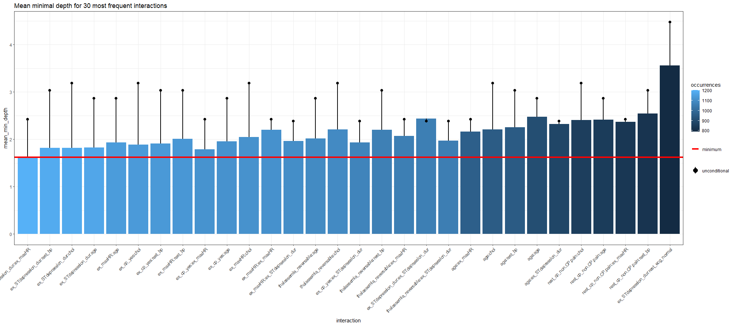
SPLIT VARIABLES
Variable interaction: conditional minimal depth versus unconditional minimal depth
Notes:
The interaction is reflected as the mean_min_depth which is the mean conditional minimal depth, where a variable is taken as a root node/root_variable and the mean minimal depth is calculated for the other variable. The uncond_mean_min_depth represents the unconditional mean minimal depth of the variable which is the mean minimal depth of the variable without having a stipulated root variable. This value is the same as the mean value seen on the vertical bar in plot_min_depth_distribution.
Variable interaction The interactions are arranged from the most frequent occurring on the left side of the plot and in lighter blue to the least frequent occurring interaction on the right side of the plot and in darker blue. The horizontal red line represents the minimum mean_min_depth. The black lollipop represents the uncond_mean_min_depth. Similar to plot_min_depth_distribution, the ranking of interactions in plot_min_depth_interactions may change depending on the arguments for mean_sample and uncond_mean_sample.
Most frequent interaction: ST depression versus

Slide 11
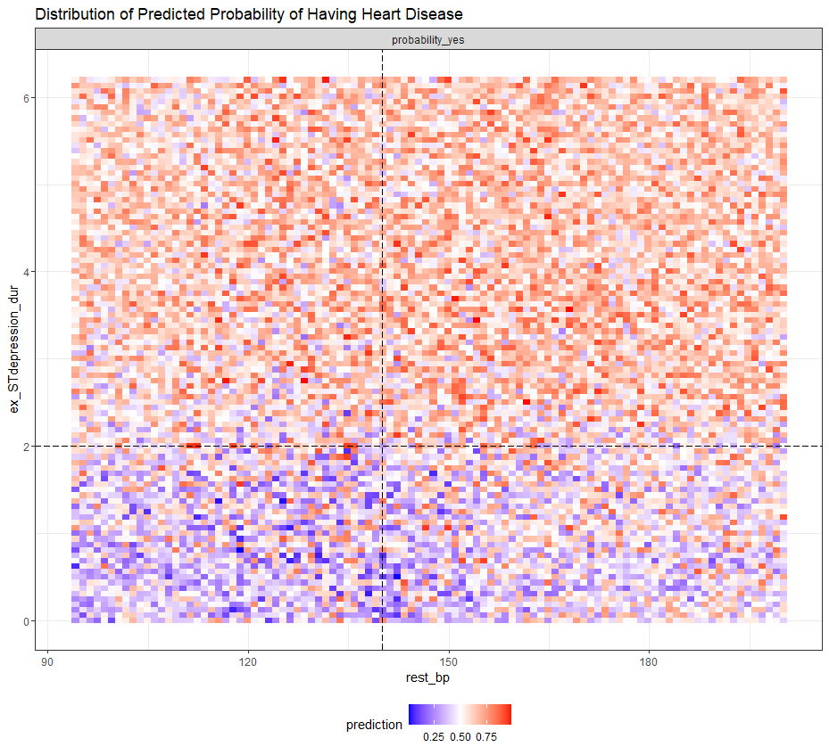
DATA VIEW
Notes:
We can further evaluate the variable interactions by plotting the probability of a prediction against the variables making up the interaction. For instance we plot the probability of having heart disease against resting blood pressure rest_bp and ST depression duration during exercise test ex_STdepression_dur. The interaction of these two variables are the most frequent interaction as seen in plot_min_depth_interactions. We plot the forest prediction against interactive variables with plot_predict_interaction.
However, there is an error when the input supplied is a model created with parsnip. There is no error when the model is created directly from the randomForest package.
ST depression duration during exercise test ex_STdepression_dur longer than 2s results in higher predicted probability of having a heart disease. The predicted probability of having heart disease for individuals with shorter ST depression duration (<2s) increases if they have high resting blood pressure rest_bp above 140.

Slide 12
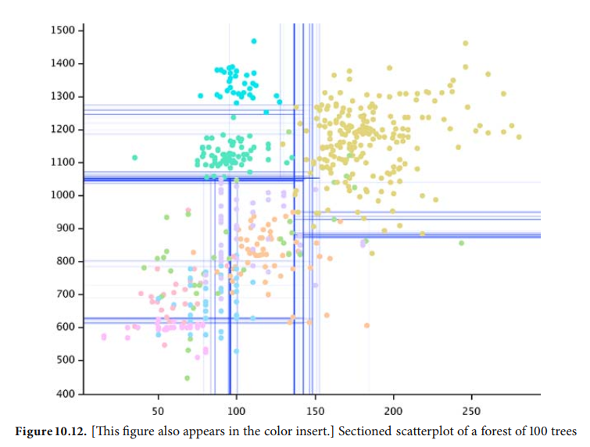
DATA VIEW
Sectioned scatterplot: visualize cutpoints
Notes:
The sectioned scatterplot displays variables linoleic
vs. palmitoleic and partition boundaries of 100 bootstrapped trees.
The use of semitransparent boundaries allows us to distinguish between occasionally used cut points
that are shown as very faint lines and frequently used cut points shown in dark blue.
In contrast to sectioned scatterplots for individual trees, we do not have the convenient ability of a drill-down, unless several models agree on the same subset. Therefore the aim of the visualization technique described in the next section is to show
all trees and their splits at a glance.

Slide 13
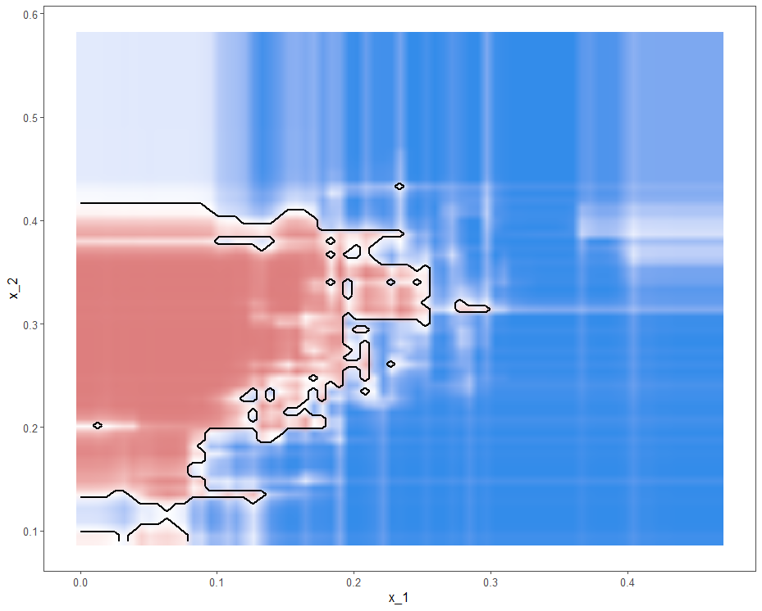
DATA VIEW
Decision boundaries

Slide 14
TRACE PLOT
The aim of a trace plot is to provide a plot that allows comparison of arbitrarily many trees with respect to splits, cut points, and the hierarchical structure.

Slide 15
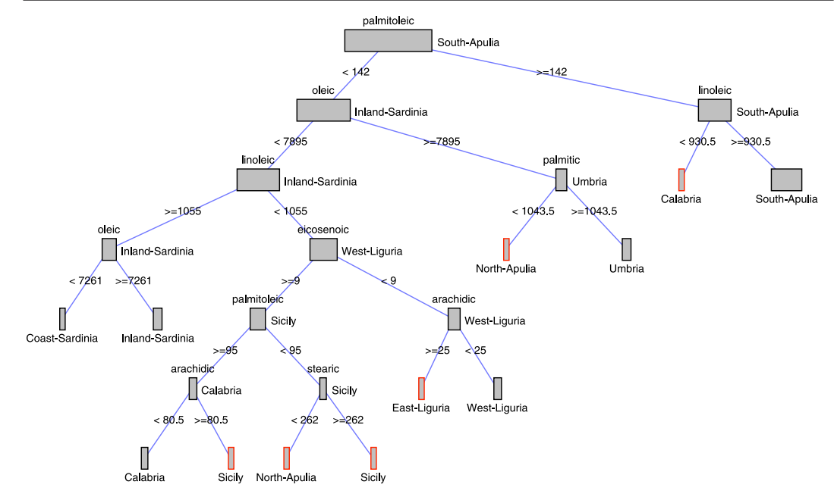
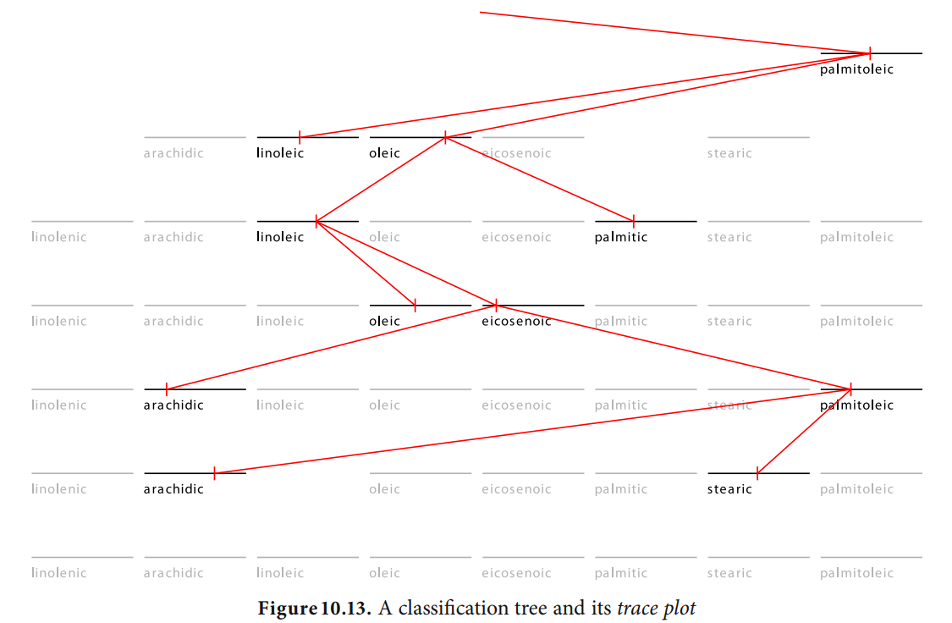
TRACE PLOT
Notes:
a rectangular grid consisting of
split variables as columns
node depths as rows
Each cell in this grid represents a possible tree node To distinguish actual split points, each cell contains a glyph representing possible split points
For continuous variables it consists of a horizontal axis, and a split
point is represented by a tick mark
Categorical variables are shown as boxes corresponding to possible split combinations

Slide 16
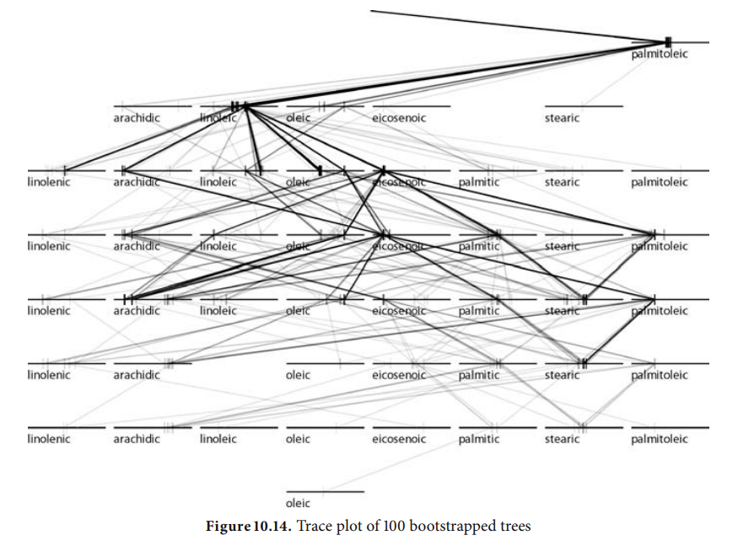
TRACE PLOT
Notes:
One important advantage of trace plots is the ability to display multiple tree models simultaneously, superimposing all models on the same grid.

